Slide 1
Generation of Anime Faces using Generative Adversarial Networks (GANs)
By Sushant Menon and Ujjwal Dubey

Slide 2
Objective
To create new, unseen anime faces using Generative Adversarial Networks and analyze the results obtained by implementing the DCGAN and WGAN.

Slide 3
Flow of the Model
Collecting the Data
Building the Generator
Building the Discriminator
Building the DC GAN
Building the WGAN
Training and Testing the model
Training and Testing the model

Slide 4
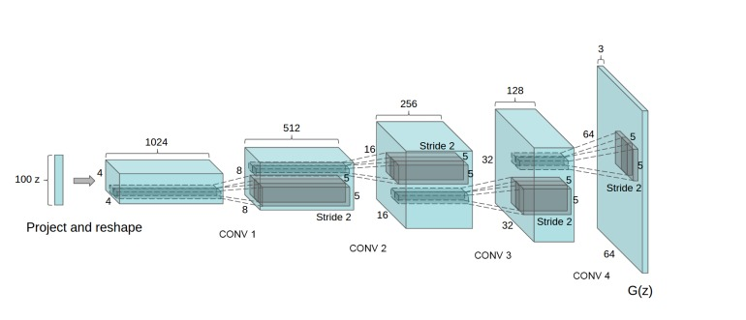
Generative Adversarial Network

Slide 5
GANs
Two neural networks compete against each other in a zero-sum game in which one agent's gain is another agent's loss.
It has 2 main Networks: The Discriminator and the Generator

Slide 6
Discriminator
In a GAN, the discriminator is simply a classifier.
It attempts to distinguish between real data and data generated by the generator.

Slide 7
Generator
The generator component of a GAN learns to generate fake data by incorporating discriminator feedback.
It learns to convince the discriminator that its output is real.

Slide 8
WGAN
The Wasserstein Generative Adversarial Network (WGAN) is a variant of generative adversarial network (GAN)
It uses the Wasserstein Loss

Slide 9
Applications
The entertainment industry and the artists who spend hours attempting to develop new characters may both benefit greatly from this specific endeavor.

Slide 10
THANK YOU!

